Slide 1
Programming with C++ Session 03 LSEG Technology 05th September 2024

Slide 2
Agenda
Smart Pointers
Templates
Data Structures
STL Algorithms
Exceptions
Boost

Slide 3
Smart Pointers
Manage the lifetime of dynamically allocated objects.
Less Bugs (reducing the likelihood of memory leaks and dangling pointers)
std::unique_ptr (Single ownership)
std::shared_ptr(Shared ownership)
std::weak_ptr (No ownership)

Slide 4
Smart Pointers - Summary
 | std::unique_ptr | std::shared_ptr | std::weak_ptr
Ownership | Exclusive | Shared | No ownership
Copyable | No (movable only) | Yes | Yes
Reference Count | No | Yes | No
Overhead | Low | Higher due to reference count | Low
Use Cases | Single owner, no shared ownership | Multiple Owners, Shared ownership | Avoid circular references and observe Objects

Slide 5
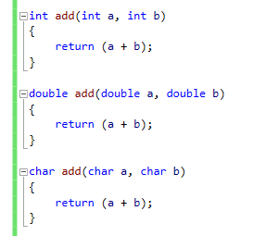
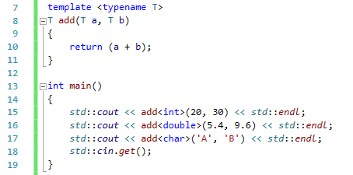
Templates
Very powerful tool in C++
Compile time code generation
Function Templates, Class Templates
Templates - cppreference.com

Slide 6
Data Structures
Array – Fixed-size collections of elements of the same type
Vector – Dynamic Arrays
Map - Collection of key-value pairs, where keys are unique
Set - Collection of unique elements stored in a sorted order
List – Dynamic size collection of elements of the same type, Doubly linked list

Slide 7
STL Algorithms
C++ Standard library come with predefined algorithms
std::find, std::find_if, std::find_if_not
std::for_each
std::max, std::min
std::sort
and many more. Refer Algorithms library - cppreference.com

Slide 8
Exceptions
To Safeguard the application
Built in, Custom exceptions
When an unexpected thing happens, you can handle it by returning a special value from the function
When a piece of code detects an exceptional situation, it throws an exception. Another piece of code catches the exception and takes appropriate action
C++ compiler doesn’t force you to catch every exception that might occur.

Slide 9
Boost
Set of libraries
Data structures and algorithms not in standard library (some)
Web service support
Some advanced date time support
Advanced regex support
Advanced string formatting support
Boost Graph Library (BGL) – for graph processing
boost::optional
https://www.boost.org/

